Slide 1

Unveiling the Dark Side of Publishing: Predatory Practices in Asian Journals
Dr. Sam T. Mathew | Senior Director, Medical Affairs, Cactus Life Sciences, India

Slide 2

Agenda
Asia’s contribution in global R&D and publications
What is predatory practice
Predatory practices in Asian journals
Retraction
Predatory journals in Asia
Plagiarism
Data fabrication
Gift authorship
Duplicate publications
Government control and censorship
Conflict of interest
Inequity in peer review
Why predatory publishing is prominent in Asia?
How to prevent predatory publishing practices in Asia?

Slide 3
Contribution of Asia in Global R&D and Publications
1
1
1
1
R&D expenditure
Science & Engineering articles
Number of patents

Slide 4

What is Predatory Practice?
"Predatory practices" denote exploitative actions by individuals or entities, often involving deceit, coercion, or aggression.
These practices span various sectors and are commonly considered unethical or illegal.
This Photo by Unknown Author is licensed under CC BY-SA

Slide 5
Predatory Practices in Asian Journals
Predatory Journals Exploitation through charging fees without proper peer review, with increased targeting in Asian countries.
Plagiarism
Presenting others' work as one's own; a global issue reported in some Asian contexts.
Data Fabrication and Falsification
Pressures leading to unethical manipulation of data; influenced by cultural and institutional factors.
Gift Authorship
Inclusion of non-contributing authors as a sign of respect in hierarchical relationships.
Duplicate Publications
Unethical practice of publishing identical research in multiple journals.
Government Control and Censorship
Possible interference stifling academic freedom and leading to biased research.
Conflict of Interest
Failure to disclose conflicts leading to research bias.
Inequity in Peer Review
Potential biases against manuscripts from certain regions and sex, affecting Asian scholars.

Slide 6
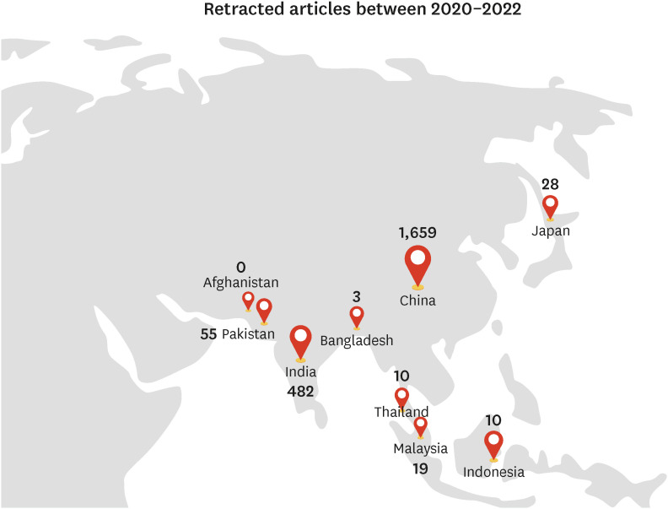
Number of retracted articles between 2020–2022*
The number of articles published in predatory journals
2010: 53,000
2014: 420,000
Global statistics of retractions
2020-2022: 10,947 articles
2019: 8,788 articles
2018: 7,401 articles
*by Retraction watch

Slide 7
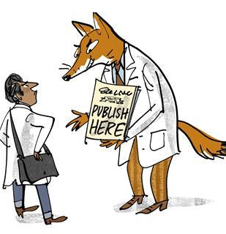
Predatory Publishing
Spam Emails: Use of deceptive emails to submit/recruitment as editor.
Fast Peer Review and Publication: False promises of rapid, often faked peer review.
Broad or Unfocused Subject Matter: Lack of specific or overly broad journal scope.
Hidden or Changing Author Fees: Deceptive practices regarding author fees.
Inconsistencies and Contradictions: Mismatches in names, scope, and fake addresses.
Fake or Unaware Editors: Misuse of names as editors without consent.
Newness and Overproduction: Quick launch and overproduction of articles without review.
Copycat Names and Websites: Imitation of well-known journals.
Author-Editor Problems: Issues with revisions, errors, consent, and payment for retraction.
Contradictory or Missing Location Info: False location claims.
Missing or Faked Identifiers: Lack of or falsified journal identifiers.
False and Imaginative Bibliometrics: Deceptive metrics and impact factors.
Inappropriate Indexing Claims: False inclusion in legitimate databases.
Amateurish or Deceptive Websites: Poor website design, including deceptive practices.

Slide 8
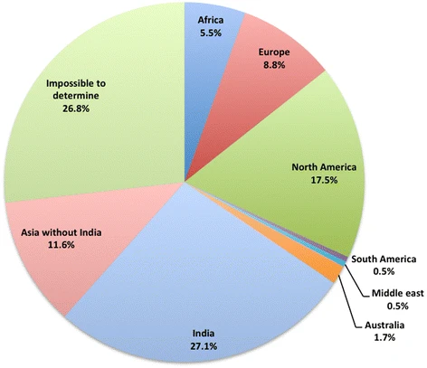
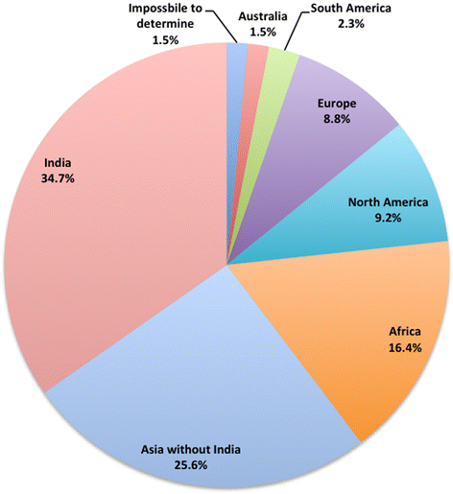
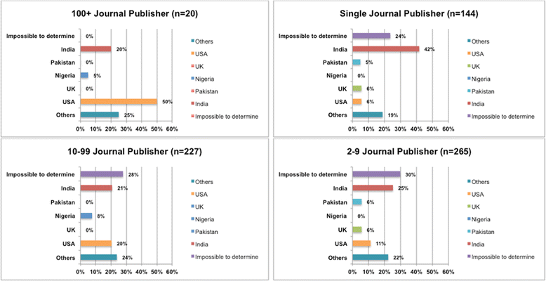
Predatory Journals in Asia: Some Statistics
Predation is a global problem. Predatory publication is significant and is significantly increasing in Asian countries
Distribution of publishers
Distribution of Authors
Distribution of publishers

Slide 9

Plagiarism in Asian Journals
COPE Study
  25% of papers in Asian journals contained plagiarized content
Shamseer et al. (2017)
  Average plagiarism rate in Asian journals is 21.9% vs 10.2% in non-Asian journals.
Most common type
  Self-plagiarism, reusing one's own work without proper citation.
Other types of plagiarism
  Copy-paste, patchwork
Highest rates of plagiarism
  China, India, and Pakistan.
This Photo by Unknown Author is licensed under CC BY-SA

Slide 10
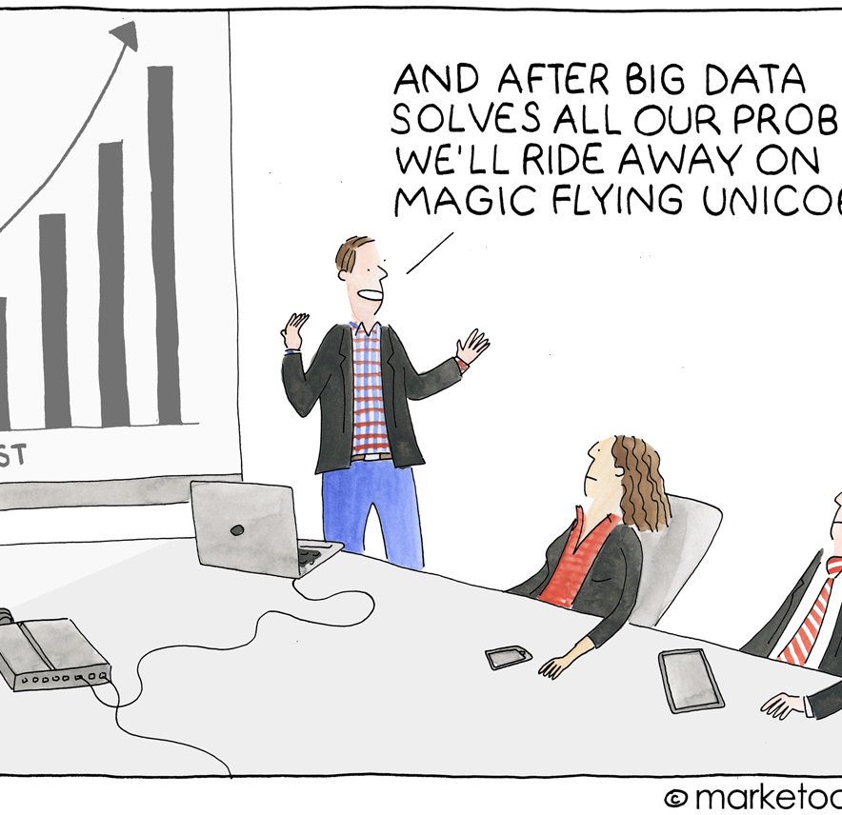
Data Fabrication and Falsification
Fanelli D (2009)
  Of > 2 million scientific articles published globally every year, approximately 2% of authors admit data fabrication.
  When asked about colleagues' data misconduct, 14–19% of authors confirmed awareness.
Looi et al. (2018)
  29% of journals across Asia experienced data falsification and 27% experienced fraudulent data/image manipulation.
COPE
  22% of articles in Asian journals were retracted due to data fabrication or falsification, vs 13% in non-Asian journals.
This Photo by Unknown Author is licensed under CC BY-SA-NC

Slide 11

Gift authorship
Salita, J. T. (2012): 40% of papers published in Asian Journals have at least one author who did not make a significant intellect
Al-Herz (2014): 18.2% of respondents admitted gift authorship in their most recent publication.
Rohwer et al (2017):
  Gift authorship was particularly prevalent in Chinese journals, with 60% of papers
  60% of researchers in East Asia reported that they had been gifted authorship on a paper,
  40% of researchers reported that they had gifted authorship to someone else.
Misra et al (2020): Gift authorship was common in Indian journals, with 30% of papers

Slide 12

Duplicate Publications
Rate of duplicate publications in
  Asian journals: 11.1%, compared to 6.7% in non-Asian journals (Moher et al. [2019])
  Chinese medical journals: 12.2% (Shen et al. [2017])
  Indian medical journals was 10.3% (Nagai et al. [2018])

Slide 13

Government Controls and censorships
51% of Indian medical faculty felt pressured to publish for job reasons, prompting some to consider predatory journals (Aggarwal et al. 2016).
60% of researchers in India and 70% of researchers in China felt pressure to publish in high-impact journals (Nagai et al. [2020] and Shen et al. [2019]).
65% of researchers in Asia felt pressure to publish in high-impact journals (Moher et al. [2021]).
This Photo by Unknown Author is licensed under CC BY-SA

Slide 14

Conflict of interest related issues
At least one author with a COI
  Asian journals - 40% (Moher et al [2012])
  Journals from India: 50% (Salita et al [2013])
  Journals from China: 30% (Nagai et al [2014])
This Photo by Unknown Author is licensed under CC BY-SA-NC

Slide 15
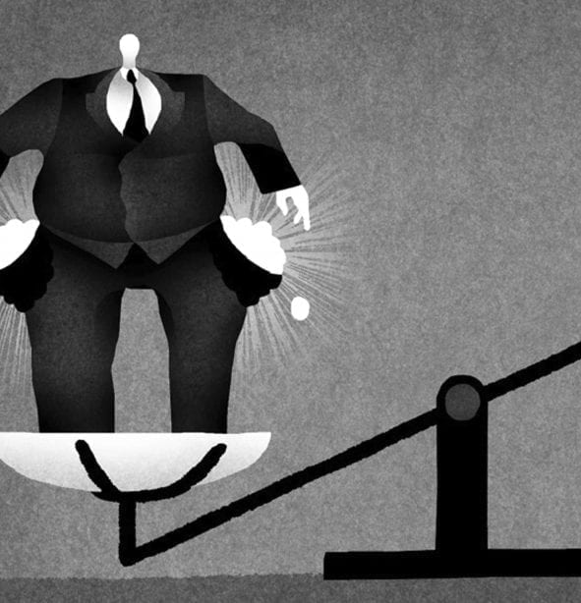
Inequality in Peer Review
Gender bias
only 20% of reviewers for Asian journals were women (Moher et al. [2015])
only 15% of editors for Asian journals were women (Nagai et al. (2016))
only 10% of editorial board members for Asian journals were women (Shen et al. (2017)
Geographic bias
>50% of peer reviewers come from developed countries except Asia (Else, [2018])
Bias Against Non-Native English Authors
Manuscripts from non-native English-speaking countries (which include many Asian countries) can face biases in peer review due to language and presentation (Ross et al. [2006]).
This Photo by Unknown Author is licensed under CC BY-NC

Slide 16
Why Predatory Publishing is Prominent in Asia?
Rapid Academic Growth Expansion in education and research sectors in Asia; increased pressure to publish.
Publish or Perish Culture Pressure to publish often may lead academics to predatory journals.
Lack of Awareness and Training
Early-career researchers might unintentionally engage with predatory publishers.
Language Barriers
Non-native English speakers may find predatory journals an easier option.
Regulatory and Institutional Factors
Institutional rewards and lack of regulation might promote predatory publishing.
Economic Factors
Lower-cost predatory journals attract researchers with limited funding.
Cultural Factors Hierarchical pressures and respect for seniority may influence publishing choices.
Global Reach of Predatory Publishers
Aggressive marketing targets researchers, including those in Asia.
Lack of Access to Quality Journals
Barriers to reputable journals might drive researchers toward predatory ones.
Legal and Governmental Framework
Absence of stringent laws and enforcement can exacerbate the problem.
Transformation to Electronic Publishing
Shift to digital delivery and e-licensing in subscription journals since the millennium change.
Rise of Open Access Models Emergence of various OA models, including gold, green, free access, and hybrid, allowing authors to pay for services like free content access.
Growth and Innovation in OA Journals
Rapid increase in OA journals using APCs, with innovations like new peer review practices in journals like PLOS ONE.

Slide 17

How to Prevent Predatory Publishing in Asia?
Educate researchers on predatory journals
Strengthen Regulations and Enforcement
Institutional Policies and Incentives
Enhanced Peer Review and Editorial Standards
Promote Access to Quality Journals
Utilize Technology and Tools
Engage with Global Initiatives
Foster a Culture of Integrity
Language Support
Transparency in Fees and Charges
Centralized National Databases
This Photo by Unknown Author is licensed under CC BY-SA-NC

Slide 18

References
Aggarwal R, Gogtay N, Kumar R, Sahni P; Indian Association of Medical Journal Editors. The revised guidelines of the Medical Council of India for academic promotions: Need for a rethink. J Postgrad Med. 2016;62(2):69-72.
Al-Herz W, Haider H, Al-Bahhar M, Sadeq A. Honorary authorship in biomedical journals: how common is it and why does it exist? J Med Ethics. 2014;40(5):346-348. doi:10.1136/medethics-2012-101311.
Asia can boost growth through technological leapfrogging, McKinsey Global Institute, December 2, 2020
Else, H (2018). Radical open-access plan could spell end to journal subscriptions. Nature 561, 17–19. doi: 10.1038/d41586-018-06178-7
Fanelli D (2009) How Many Scientists Fabricate and Falsify Research? A Systematic Review and Meta-Analysis of Survey Data. PLoS ONE 4(5): e5738. https://doi.org/10.1371/journal.pone.0005738
Looi, C. Y., Tan, Y. H., & Tan, L. G. (2018). Data integrity in biomedical research: A survey of Asia-Pacific medical journals. Journal of the Medical Library Association, 106(2), 129-134. doi:10.5195/jmla.2018.383
Misra, R., Ravindran, A., & Agarwal, A. (2020). Gift authorship in Indian medical journals: A cross-sectional study. Frontiers in Psychology, 11, 531177.
Moher, D., Glasziou, P., Chalmers, I., & Dickersin, K. (2019). Duplicate publication of research: A systematic review. PLoS Medicine, 16(10), e1002891.
Moher, D., Glasziou, P., Chalmers, I., & Dickersin, K. (2021). Pressure to publish in high-impact journals among researchers in Asia: A systematic review. PLoS Medicine, 18(1), e1003473.
Moher, D., Pham, B. Q., Jones, A., & Glasziou, P. (2012). Conflict of interest in biomedical research: A systematic review of prevalence, disclosure, and management. JAMA Internal Medicine, 172(2), 118-128.)
Moher, D., Shamseer, L., & Clarke, M. (2015). Gender bias in peer review: A systematic review. JAMA Internal Medicine, 175(1), 78-84.
Nagai, Y., Kato, H., & Okamoto, Y. (2014). Conflict of interest in Chinese medical journals: A cross-sectional study. Journal of the Association of Physicians of India, 62(1), 17-21.
Nagai, Y., Kato, H., & Okamoto, Y. (2016). Gender bias in the editorial process of medical journals: A cross-sectional study. Journal of the Association of Physicians of India, 64(1), 17-21.

Slide 19
References
Nagai, Y., Kato, H., & Okamoto, Y. (2018). Duplicate publication in Indian medical journals: A cross-sectional study. Journal of the Association of Physicians of India, 66(1), 13-17.
Nagai, Y., Kato, H., & Okamoto, Y. (2020). Pressure to publish in high-impact journals among researchers in India: A cross-sectional study. Journal of the Association of Physicians of India, 68(2), 8-10.
Rodrigues, F., Gupta, P., Khan, A. P., Chatterjee, T., Sandhu, N. K., & Gupta, L. (2023). The Cultural Context of Plagiarism and Research Misconduct in the Asian Region. Journal of Korean Medical Science, 38(12). https://doi.org/10.3346/jkms.2023.38.e88.
Rohwer, B., Yong, Y., Wager, E., & Garner, R. (2017). Gift authorship in Chinese biomedical research. Research Integrity and Peer Review, 2(1), 1-10.
Ross, J. S., Gross, C. P., & Desai, M. M. (2006). Effect of blinded peer review on abstract acceptance. JAMA, 295(14), 1675-1680.
Salita, A., Krishnaswamy, G., & Das, A. (2013). Conflict of interest in Indian medical journals: A cross-sectional study. Journal of Empirical Research on Human Research Ethics, 8(2), 11-18
Salita, J. T. (2012). Gift authorship in Asian journals: A preliminary study. Science and Engineering Ethics, 18(3), 567-578.
Shamseer, L., Moher, D., Maduekwe, O. et al. Potential predatory and legitimate biomedical journals: can you tell the difference? A cross-sectional comparison. BMC Med 15, 28 (2017). https://doi.org/10.1186/s12916-017-0785-9
Shen C, Björk BC. ‘Predatory’ open access: a longitudinal study of article volumes and market characteristics. BMC Medicine. 2015;13:230.
Shen, C., Björk, BC. ‘Predatory’ open access: a longitudinal study of article volumes and market characteristics. BMC Med 13, 230 (2015). https://doi.org/10.1186/s12916-015-0469-2
Shen, Y., Zhang, J., & Li, L. (2017). Duplicate publication in Chinese medical journals: A cross-sectional study. Journal of Medical Ethics, 43(1), 33-37.)
Shen, Y., Zhang, J., & Li, L. (2017). Gender bias in editorial board membership of medical journals: A cross-sectional study. Journal of Medical Ethics, 43(1), 30-33.
Shen, Y., Zhang, J., & Li, L. (2019). Pressure to publish in high-impact journals among researchers in China: A cross-sectional study. Journal of Medical Ethics, 45(1), 36-40.

Slide 20

THANK YOU

